Slide 1


Quanto Credit Default Swaps
Theory, Pricing & Practice
Nicholas Burgess

Slide 2
PART ONE: Theory
Quanto CDS
Introduction to Quanto CDS
CDS Pricing & Par Spread
The Quanto Market Data Problem
Quanto FX Risks
Quanto Market Data Adjustments
Quanto FX Jump Risk Explained
Quanto Hazard Rates
PART TWO: Pricing & Practice
Case Studies
Eurozone: Quanto Effect
Italy: CDS Par Spreads, EUR vs USD
Japan: Sovereign & Corporate Basis Spreads
Brazil: Quanto CDS & Basis
Brazil: Corporate Implied FX Jumps
Brazil: Quick Rules of Thumb
Quanto CDS Research & Support Materials
www.link-to-excel-and-python-examples.com

Slide 3
PART ONE - THEORY
Quanto CDS

Slide 4

Quanto CDS – Introduction to Quanto CDS
Credit Default Swap
An insurance contract to protect against losses should the reference bond default
The protection buyer pays regular Fixed Premiums in exchange for the Loss Given Default, LGD = N( 1 – RR)
Liquid vs Contractual Currency
The Liquid Currency for a CDS contract is USD, regardless of bond domicile & issue currency
When the CDS Contractual Currency is not the liquid currency, the CDS is considered a Quanto CDS

Slide 5
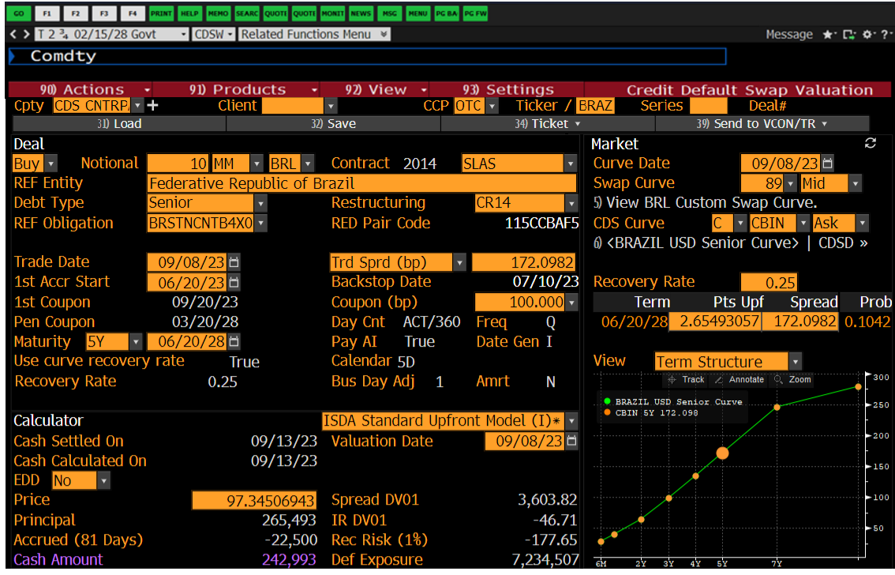
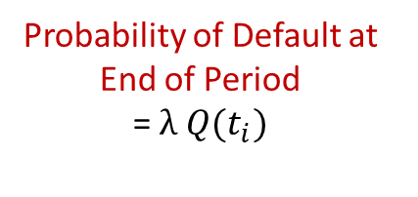
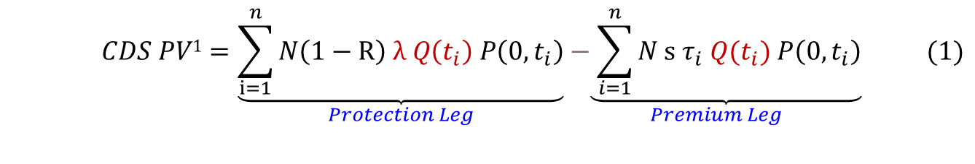
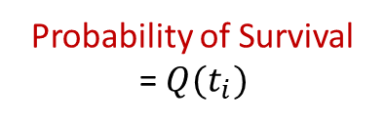
Credit Default Swaps – Pricing
Probability of Default at End of Period
= $λ Q(t_{i})$
Probability of Survival
= $Q(t_{i})$
Present Value is the sum of Risky Discounted cash flows
$$\begin{aligned} CDS PV1=\underset{Protection Leg}{\underbrace{\sum_{i=1}^{n}{N\left(1−R\right) λ Q\left(t_{i}\right) P\left(0,t_{i}\right)}}}\underset{Premium Leg}{−\underbrace{ \sum_{i=1}^{n}{N s τ_{i} Q(t_{i}) P\left(0,t_{i}\right)}}} \#(1)\end{aligned}$$

Slide 6
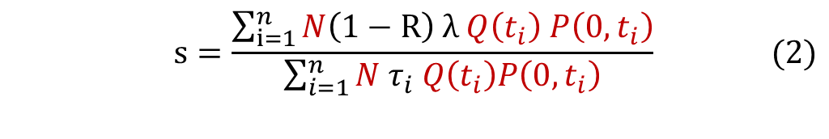

Credit Default Swaps – Par Spread
Quotation
CDS contracts typically quote as a Par Spread, s
This is the spread that makes the premium and protection leg PVs equal.
Par Spread Formula
Setting the PV in equation (1) to zero and rearranging gives (2),
$$\begin{aligned}s=\frac{\sum_{i=1}^{n}{N\left(1−R\right) λ Q\left(t_{i}\right) P\left(0,t_{i}\right)}}{\sum_{i=1}^{n}{N τ_{i} Q\left(t_{i}\right)P\left(0,t_{i}\right)}}\#\#\#\#(2)\end{aligned}$$
Par Spread Rule of Thumb
Terms in red cancel and assuming annual premiums i.e., $τ=1$ gives a simple rule of thumb,
$$\begin{aligned} \begin{aligned}s≈\left(1−R\right) λ\#\#\#\#\#\#\#\#\#\#\#\#\#\#\#\#\#\#\#\end{aligned} \#\left(3\right)\end{aligned}$$

Slide 7
Quanto CDS – The Quanto Market Data Problem
The Problem – Market Data in a Different Currency (USD)
We want to price a BRL CDS on a BRL Sovereign Bond.
However, only USD CDS market data quotes are available.
The Solution – Quanto Market Data Adjustments
Brigo, Pede and Petrelli (2018) suggest we make a Quanto Adjustment to the USD market data.
Naming conventions, they call BRL the Contract currency ( or Quanto) and USD the Liquid currency.
They derive a model to convert USD hazard rates into BRL equivalent rates.
The quanto adjustment incorporates FX crash risk and FX covariance risk.

Slide 8
Quanto CDS – Quanto FX Risks
Quanto FX Risk
We want to trade BRL CDS to buy/sell protection on a BRL Bond
Typically, the BRL Quanto CDS will be illiquid, so we might use liquid USD CDS market data as a proxy.
When using USD market data to price Quanto CDS we need to adjust for Quanto FX risk
Quanto FX Risk = Crash Risk + Covariance Risk
FX Crash Risk
FX devaluation or crash risk on default
Quanto CDS Spreads cheapen relative to USD
FX Covariance Risk
FX covariance with credit spreads
As default intensity increases, Quanto currency weakens
Quanto protection becomes cheap relative to USD

Slide 9
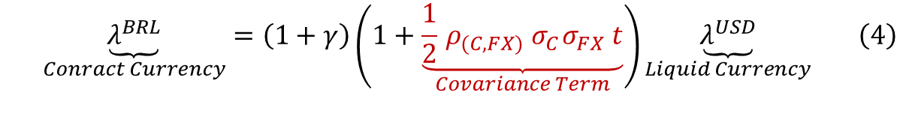
Quanto CDS – Quanto Market Data Adjustments
Quanto Market Data Adjustment
Li, Mercurio & Resnick (2018) present a quanto market data adjustment formula in [1], see equation (25)
$$\begin{aligned}\underset{Conract Currency}{\underbrace{λ^{BRL}}}=\left(1+γ\right)\left(1+\underset{Covariance Term}{\underbrace{\frac{1}{2}{ ρ}_{(C,FX)}{ σ}_{C}σ_{FX} t}}\right)\underset{Liquid Currency}{\underbrace{λ^{USD}}}\#\left(4\right)\end{aligned}$$
The FX jump parameter, γ captures a single FX jump at default in %
The FX jump dominates and covariance is a second order effect
Setting the covariance term to zero we get a useful approximation or ‘rule of thumb’.
$$\begin{aligned}λ^{BRL}=\left(1+γ\right)λ^{USD}\#\left(5\right)\end{aligned}$$
Equivalently, using (3) gives an expression in terms of CDS par spreads, s
$$\begin{aligned}s^{BRL}=\left(1+γ\right)s^{USD}\#\left(6\right)\end{aligned}$$

Slide 10
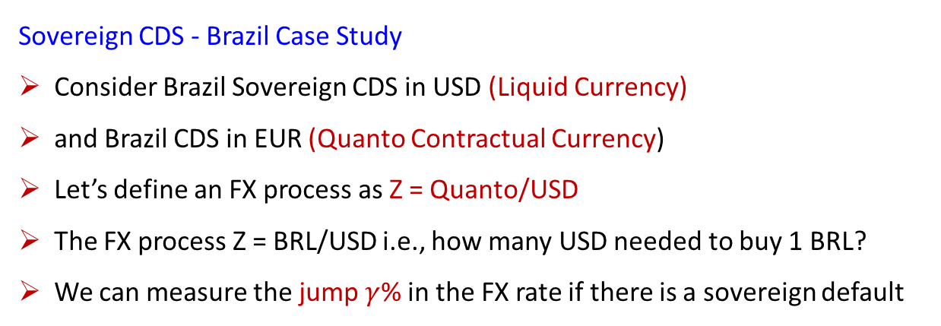
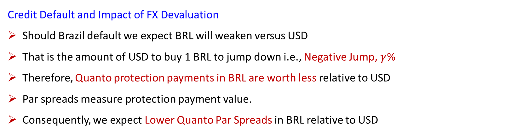
Credit Default Swaps – FX Jump on Default Explained
Sovereign CDS - Brazil Case Study
Consider Brazil Sovereign CDS in USD (Liquid Currency)
and Brazil CDS in EUR (Quanto Contractual Currency)
Let’s define an FX process as Z = Quanto/USD
The FX process Z = BRL/USD i.e., how many USD needed to buy 1 BRL?
We can measure the jump $γ$% in the FX rate if there is a sovereign default
Key Points
Negative FX Jump on Default
i.e. BRL Devaluation
Quanto Protection Cheapens Relative to USD
Lower Quanto CDS Spreads
USD CDS > BRL CDS
Credit Default and Impact of FX Devaluation
Should Brazil default we expect BRL will weaken versus USD
That is the amount of USD to buy 1 BRL to jump down i.e., Negative Jump, $γ$%
Therefore, Quanto protection payments in BRL are worth less relative to USD
Par spreads measure protection payment value.
Consequently, we expect Lower Quanto Par Spreads in BRL relative to USD

Slide 11
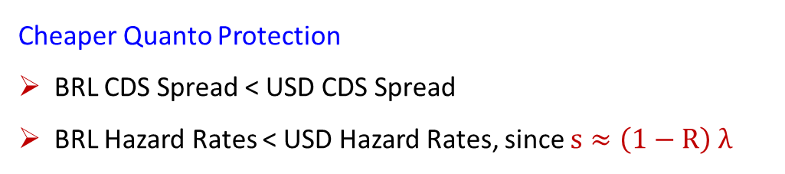
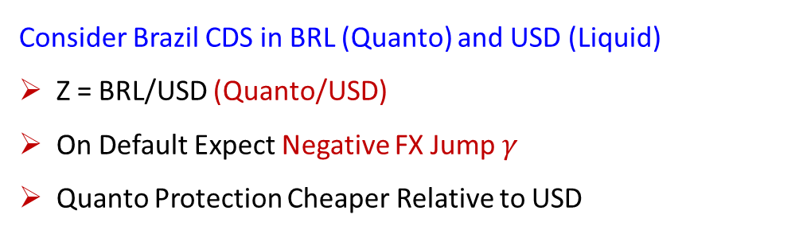
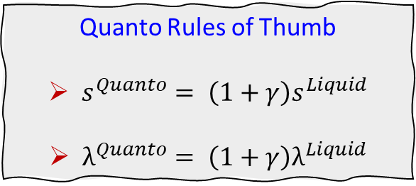
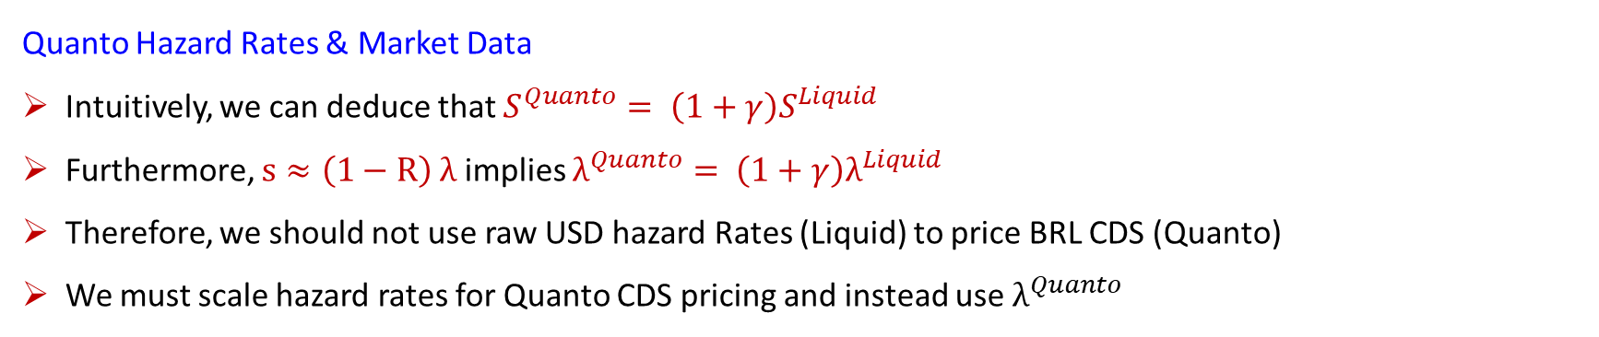
Credit Default Swaps – Quanto Hazard Rates
Consider Brazil CDS in BRL (Quanto) and USD (Liquid)
Z = BRL/USD (Quanto/USD)
On Default Expect Negative FX Jump $γ$
Quanto Protection Cheaper Relative to USD
Quanto Rules of Thumb
$s^{Quanto}= \left(1+γ\right)s^{Liquid}$
$λ^{Quanto}= \left(1+γ\right)λ^{Liquid}$
Cheaper Quanto Protection
BRL CDS Spread < USD CDS Spread
BRL Hazard Rates < USD Hazard Rates, since $s≈\left(1−R\right) λ$
Quanto Hazard Rates & Market Data
Intuitively, we can deduce that $S^{Quanto}= \left(1+γ\right)S^{Liquid}$
Furthermore, $s≈\left(1−R\right) λ$ implies $λ^{Quanto}= \left(1+γ\right)λ^{Liquid}$
Therefore, we should not use raw USD hazard Rates (Liquid) to price BRL CDS (Quanto)
We must scale hazard rates for Quanto CDS pricing and instead use $λ^{Quanto}$

Slide 12
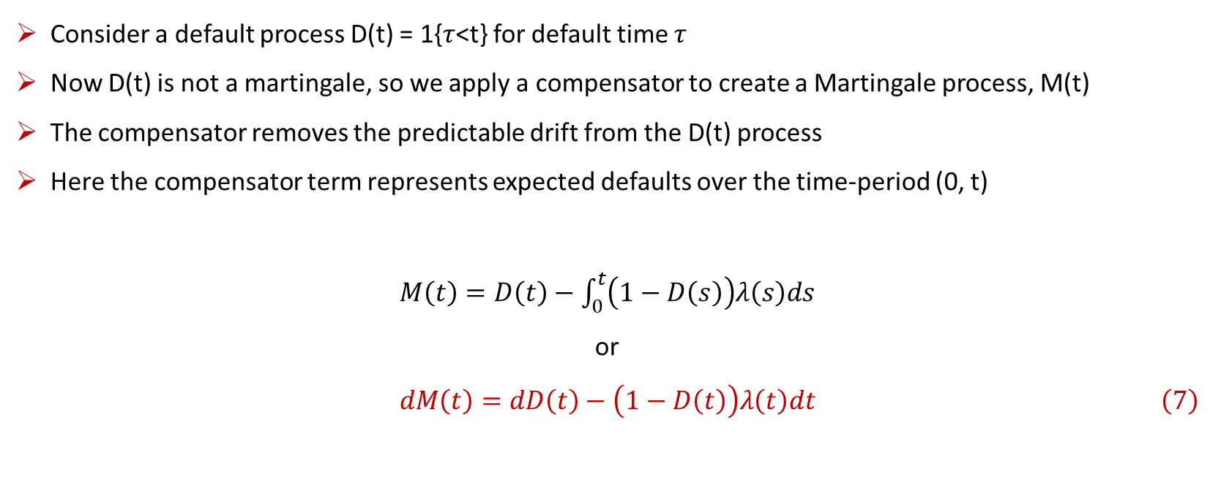
Credit Default Swaps – Mathematics of Quanto Hazard Rates I
Consider a default process D(t) = 1{$τ$<t} for default time $τ$
Now D(t) is not a martingale, so we apply a compensator to create a Martingale process, M(t)
The compensator removes the predictable drift from the D(t) process
Here the compensator term represents expected defaults over the time-period (0, t)
$M\left(t\right)=D\left(t\right)−$ $\int_{0}^{t}{\left(1−D\left(s\right)\right)λ\left(s\right)ds}$
or
$$\begin{aligned}dM\left(t\right)=dD\left(t\right)−\left(1−D\left(t\right)\right)λ\left(t\right)dt\#\left(7\right)\end{aligned}$$

Slide 13
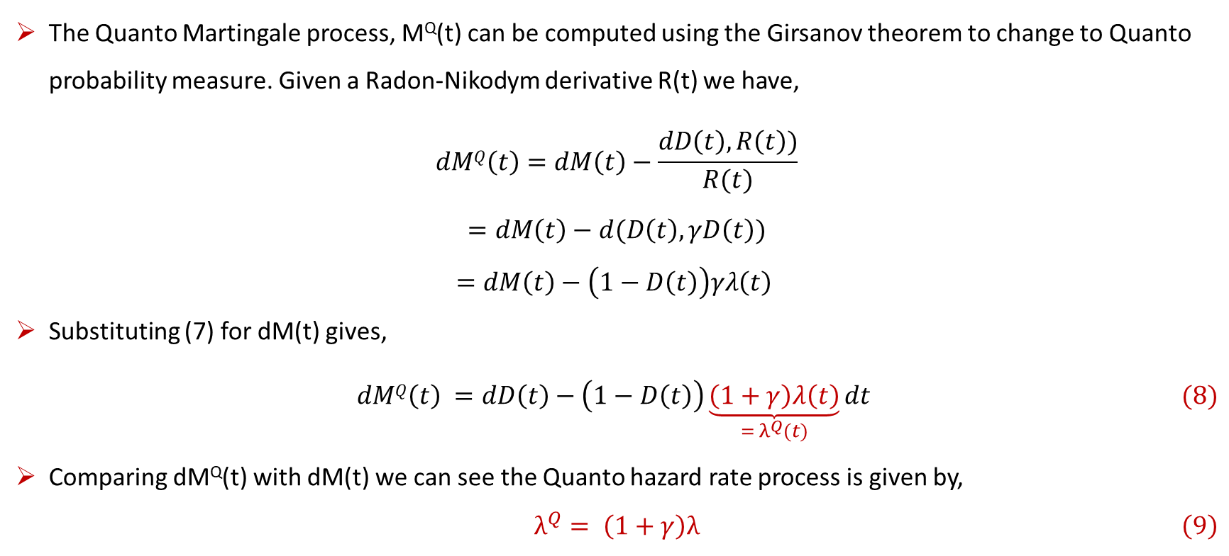
Credit Default Swaps – Mathematics of Quanto Hazard Rates II
The Quanto Martingale process, M^{Q}(t) can be computed using the Girsanov theorem to change to Quanto probability measure. Given a Radon-Nikodym derivative R(t) we have,
$$dMQ\left(t\right)=dM\left(t\right)−\frac{dD\left(t\right),R\left(t\right))}{R(t)}$$
$$=dM\left(t\right)−d(D\left(t\right),γD\left(t\right)) \\ =dM\left(t\right)−\left(1−D\left(t\right)\right)γλ\left(t\right)$$
Substituting (7) for dM(t) gives,
$$\begin{aligned}dMQ\left(t\right) =dD\left(t\right)−\left(1−D\left(t\right)\right)\underset{= λ^{Q}(t)}{\underbrace{\left(1+γ\right)λ\left(t\right)}}dt \#(8)\end{aligned}$$
Comparing dM^{Q}(t) with dM(t) we can see the Quanto hazard rate process is given by,
$$\begin{aligned} λ^{Q}= \left(1+γ\right)λ \#\left(9\right)\end{aligned}$$

Slide 14
PART TWO – PRICING & PRACTICE
Case Studies
Quanto Credit Default Swaps

Slide 15
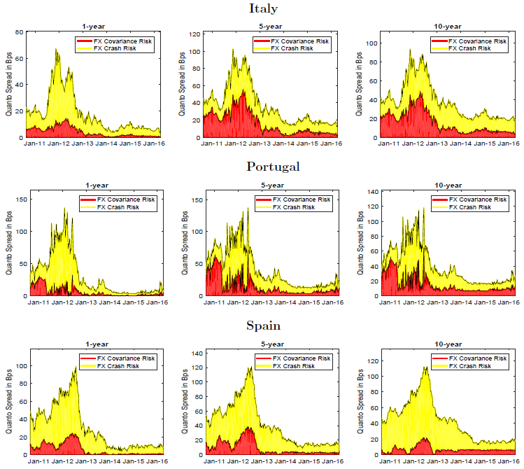
Eurozone Case Study – Quanto Effect on CDS Spreads
Eurozone FX Crash Risk
Varies depending on credit regime & market distress
On average accounts for ca. 10 bps of the Quanto Basis
Eurozone FX Covariance
Similar to FX crash risk, covariance risk of ca. 10 bps
Covariance risk grows with CDS maturity
Eurozone Quanto Basis
Combining FX Crash and Covariance Risk
Total Quanto Basis ≈ 20 bps
i.e. USD CDS Spread > EUR CDS Spread
Source: Lando & Nielson (2018)

Slide 16
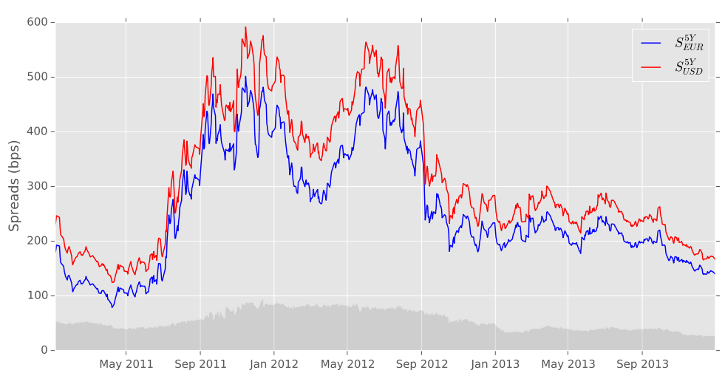
Italy Case Study – CDS Par Spreads EUR vs USD
Quanto Par Spreads
Typically, Quanto CDS spreads are lower than the liquid currency CDS in USD
Italy CDS Spreads: EUR vs USD
Italy CDS spreads in EUR (Quanto) are lower than those in USD by ca. 20 bps
Italy CDS Spreads, Source: Brigo (2016) – Quant Summit Europe

Slide 17
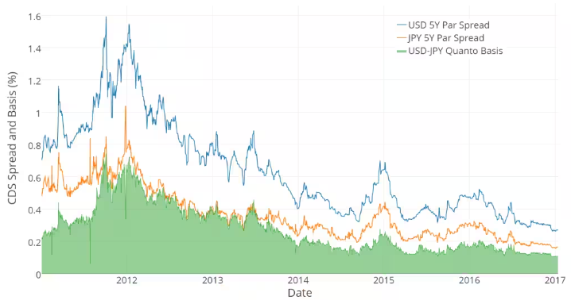

Japan Case Study – Sovereign Quanto Basis Spread
Quanto Basis
The difference between USD and Quanto CDS Spreads is called the Quanto Basis
$$s^{JPY}= \left(1+γ\right)s^{USD}$$
Japan Sovereign CDS Spreads
Japan CDS spreads in JPY (Quanto) are lower than those in USD by ca. 20 bps
Japan Sovereign CDS Spreads, Source: S&P Global (2018)

Slide 18
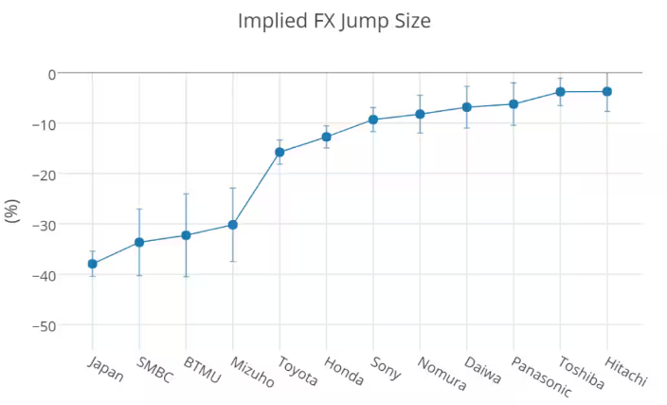

Japan Case Study – Corporate Quanto Basis
How to Imply FX Jump Sizes and Quanto Basis for Corporates?
In Japan corporate CDS market, significant negative FX Jumps (JPY Devaluation) priced in.
FX jump sizes are strongly correlated with systemic importance of corporate
There is evidence of similar FX jump sizes across industry groups. Suggests possibility of building sector basis curves
$$γ=\left(\frac{S^{JPY}}{S^{USD}}−1\right)$$
Japan Corporate Implied FX Jump Sizes, Source: S&P Global (2018)

Slide 19
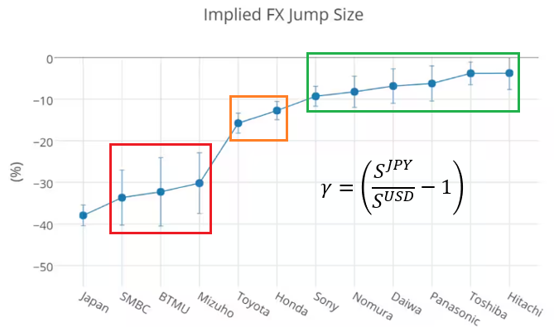
Japan Case Study – Industry Sector Implied FX Jump Sizes
Sector Basis Curves
There is evidence of similar FX jump sizes across industry groups. Jump sizes correlated to systemic importance.
JPY Implied Jump Sizes by Sector
JPY Sovereign -40%
JPY Banking Sector -35%
JPY Automotive Sector -15%
(Automotive sector constitutes 90% of total GDP!)
JPY Large Corporates -10%
JPY Mid-Small Corporates -5%
JPY Implied FX Jump Sizes by Sector, Source: S&P Global (2018)

Slide 20
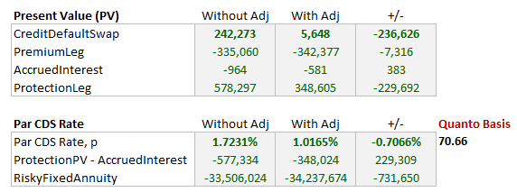
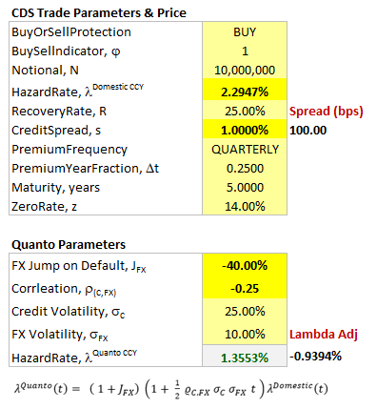
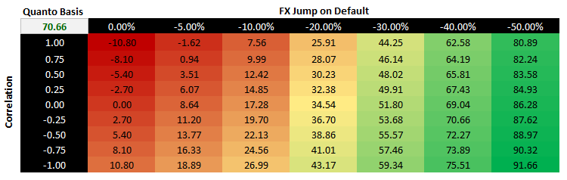
Brazil Case Study – Quanto CDS & Quanto Basis
Brazil Sovereign CDS Spreads (BRL)
Consider an FX jump of -40%
CDS spreads in BRL (Quanto) would be lower than those in USD by ca. 71 bps
What-If Analysis

Slide 21
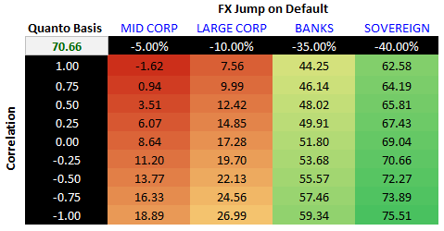
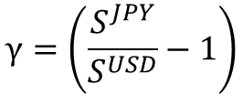
Brazil Case Study – Corporate Implied FX Jumps
Brazil Implied FX Jump (Estimates)
Sovereign -40%
Banking Sector -35%
Large Corporates -10%
Mid-Small Corporates -5%
What-If Analysis
Can be implied from Direct Market Quotes
or Sector Quanto Basis Curves
$$γ=\left(\frac{S^{JPY}}{S^{USD}}−1\right)$$

Slide 22

Brazil Case Study – Quanto CDS & Quick Rule of Thumb
Brazil Implied FX Jump (Estimates)
Sovereign -40%
Banking Sector -35%
Large Corporates -10%
Mid-Small Corporates -5%
Rule of Thumb:
$$S^{BRL}=\left(1+γ\right)S^{USD}$$
BRL Par Spreads: As a Multiple of USD CDS
Sovereign 60%
Banking Sector 55%
Large Corporates 90%
Mid-Small Corporates 95%
Example: BRL CDS(Sovereign) ≈ (1 - 40%) USD CDS
= 60% x USD CDS
= 60% x 172.10bps = 103.26 bps

Slide 23
References
Bloomberg (2016), Pricing Default-Contingent Contracts with Deterministic Credit
Brigo D., Pede N. and Petrelli A. (2018), Multi Currency Credit Default Swaps: Quanto Effects & FX Devaluation Jumps
Itkin A., Shcherbakov V. and Veygman A. (2019), A New Model for Pricing Quant Credit Default Swaps
Lando D. and Nielsen A. (2018), Quanto CDS Spreads
Li M., Mercurio F. and Resnick S. (2018), The GARCH linear SDE: Explicit formulas and the pricing of a quanto CDS

Slide 24
Contact
Have questions or want further info?
LinkedIn: www.linkedin.com/in/nburgessx

